Slide 1
Finding Data On the web

Slide 2
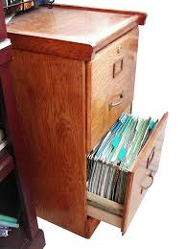
A very common data format …

Slide 3
Where is Data?
Data is Collected Every Time Something is:
Registered
Inspected
Purchased
Voted on
Surveyed

Slide 4
Finding Data on the Web:
Data Formats for Download
Portable Document Format (PDF): charts that contain data but are saved in a unified document with text
Excel file (xls): data is saved as a table readable by Microsoft Excel
Comma separated values (CSV): Plain text file with each data separated by a comma

Slide 5
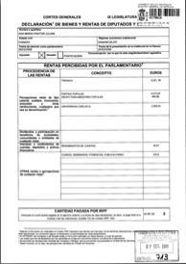
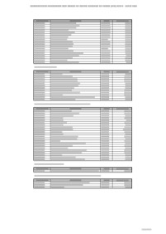
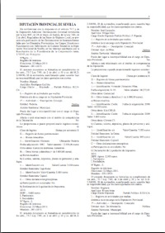
Understanding Data Formats
PDFs
Scanned Images (Unstructured, not searchable)
Computer-generated (searchable)
Tables (Structured, searchable)
Complex formats (Unstructured, searchable)

Slide 6
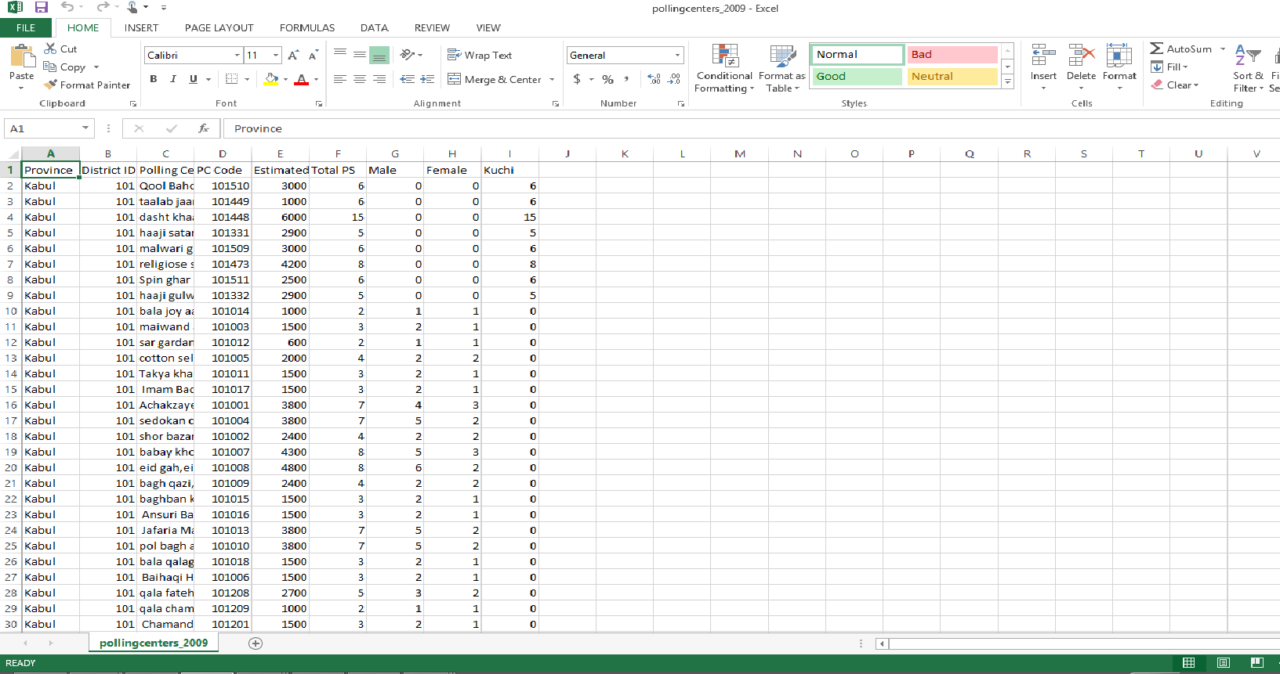
Understanding Data Formats: Machine Readable

Slide 7
Finding Data on the Web
Data Sources Online
Twitter!
Think tanks, NGOs and academics and government
Advanced Google Searches
Exercise
Summary & Conclusions

Slide 8
Finding Data on the Web
Data tweets
@Kresearcher
@ColdTusker
@OxfamEAfrica
@IHubResearch
@VirtualKenya
@AfricaReview
@AidData
@AlexAwiti

Slide 9
Finding Data on the Web
Data Sources Online
Twitter!
Think tanks, NGOs, academics and government
Advanced Google Searches
Exercise
Summary & Conclusions

Slide 10
Finding Data on the Web
Kenyan think tanks, NGOs and academics
Data Dredger
Mars Group
Africa Open Data
International Budget Partnership County Budgets
Institute of Economic Affairs
Uwezo
Kenyan Government Sources
Kenya National Bureau of Statistics
E-promis Kenya
Kenya Open Data Initiative
National Treasury

Slide 11
Finding Data on the Web
Kenya Data Reports
Kenya Demographic & Health Survey
1989, 1993, 1998, 2003, 2009, 2014
Kenya Aids Indicator Survey
2007, 2012
Kenya Service Delivery Indicators
2013
Kenya Inequalities
2004, 2007, 2013
Kenya National Economic Survey
Annual

Slide 12
Finding Data on the Web
Global and open data catalogs
World Health Organization
United Nations
World Bank
DataCatalogs.org
The Guardian's world government data portal
Google's public data directory
The data hub
DBPedia Datasets
Factual
Free GIS data
List of open data resources
Energy data repositories
World Research Institute
Data wrangling
Quora thread: "Where can I find large datasets open to the public?"
Directory of APIs
Infochimps
Datamarket
Offshore Leaks
Investigative Dashboard
Open Corporates
Natural Earth data
UNEP Data
Transparency International Corruption Index
Land Ownership Database
Gapminder World

Slide 13
Finding Data on the Web
Data Sources Online
Twitter!
Think tanks, NGOs, academics and government
Advanced Google Searches
Exercise
Summary & Conclusions

Slide 14
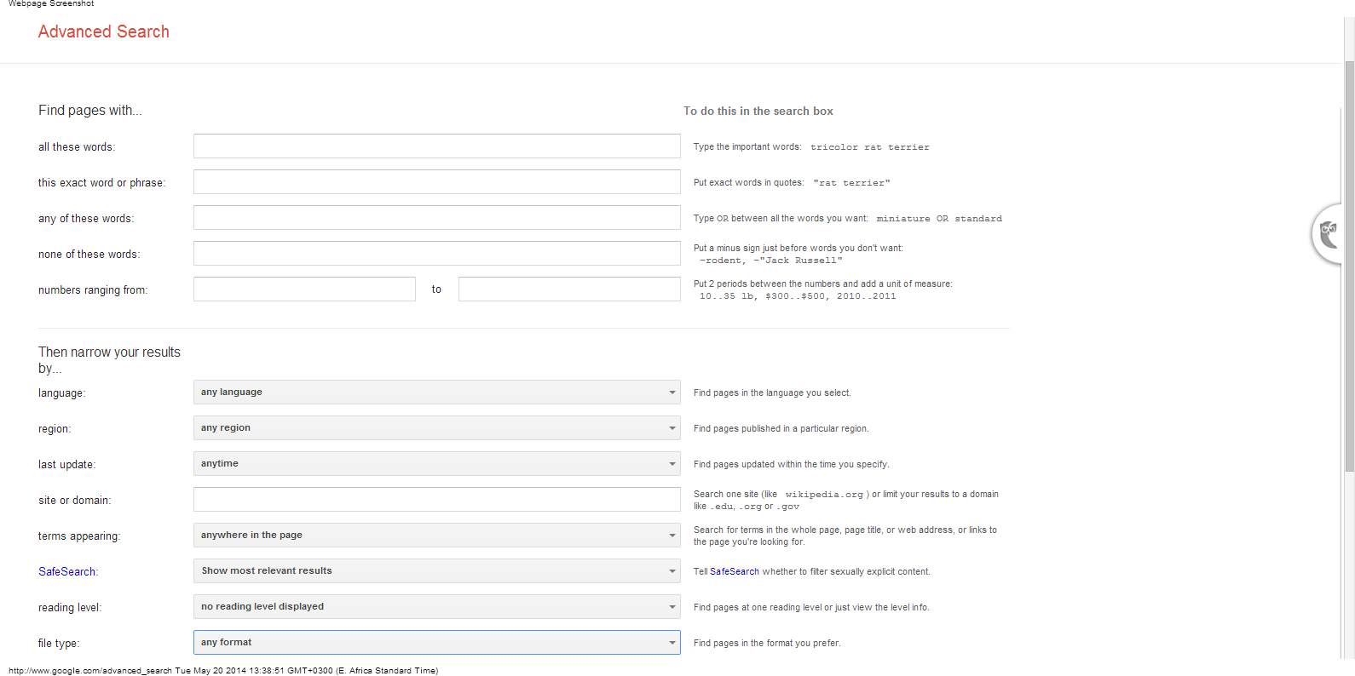
Finding Data on the Web:
Google Advanced Searches

Slide 15
Finding Data: Advanced Google Searches Shortcuts
All these words is a regular search.
Shortcut: Type in all the words you want to find.
This exact word or phrase specifies the order the words should appear
Shortcut: Use quotes to search for phrases “Kenya National Bureau of Statistics”

Slide 16
Finding Data: Advanced Google Searches Shortcuts
Any of these words use related terms for the same search
Shortcut:
Type OR to find variations of the same search: Kenya “tourism” OR “tourists” OR “visitors”
None of these words will filter out sites with words that you specify
Shortcut: Type - sign right before the word: Kenya tourism -safari

Slide 17
Finding Data: Advanced Google Searches Shortcuts
Language: specify the language of results
Region: limit to only Kenyan websites
Last Update: limit to recent content

Slide 18
Finding Data: Advanced Google Searches Shortcuts
Site or domain: Narrow search to specific website:
Shortcut
“site:url” Example “site:www.tourism.go.ke”
Filetype: search only for a specific extension
Shortcut
filetype: “Filetype:[extension]”
Example: site:www.tourism.go.ke filetype:xls

Slide 19
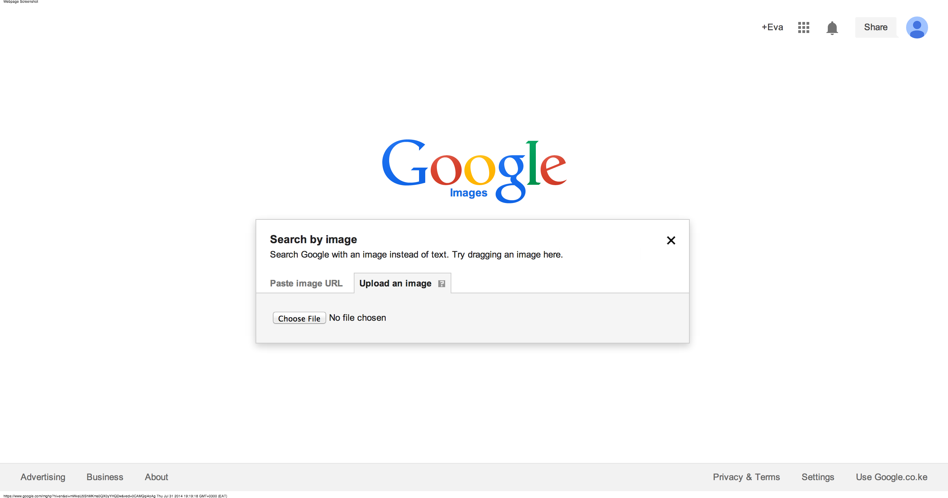
Finding Data: Advanced Google Searches Shortcuts
Search by image: go to Google Image Search and add your photo, either by URL, uploading or dragging-and-dropping from your computer.

Slide 20
Finding Data: Advanced Google Searches Shortcuts
Google trends see what people are looking at and searching for over time
Example: Type in “corruption” and “Kenya” change search from “worldwide” to “Kenya”
Also check: “devolution” and “Kenya” and check News headlines.

Slide 21
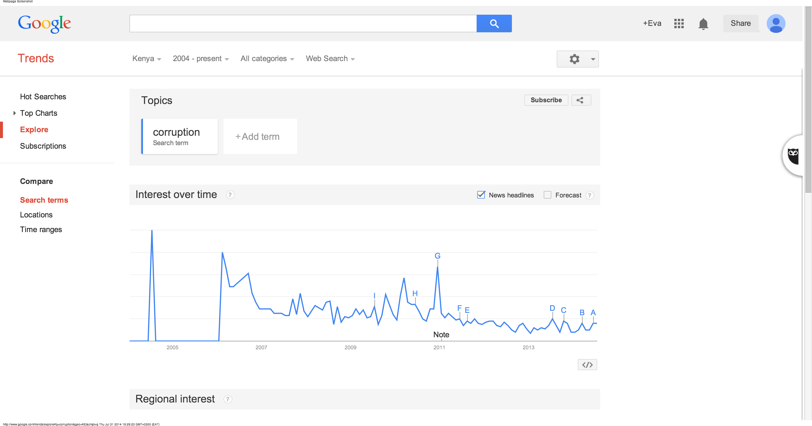
Finding Data: Advanced Google Searches Shortcuts
Google trends

Slide 22
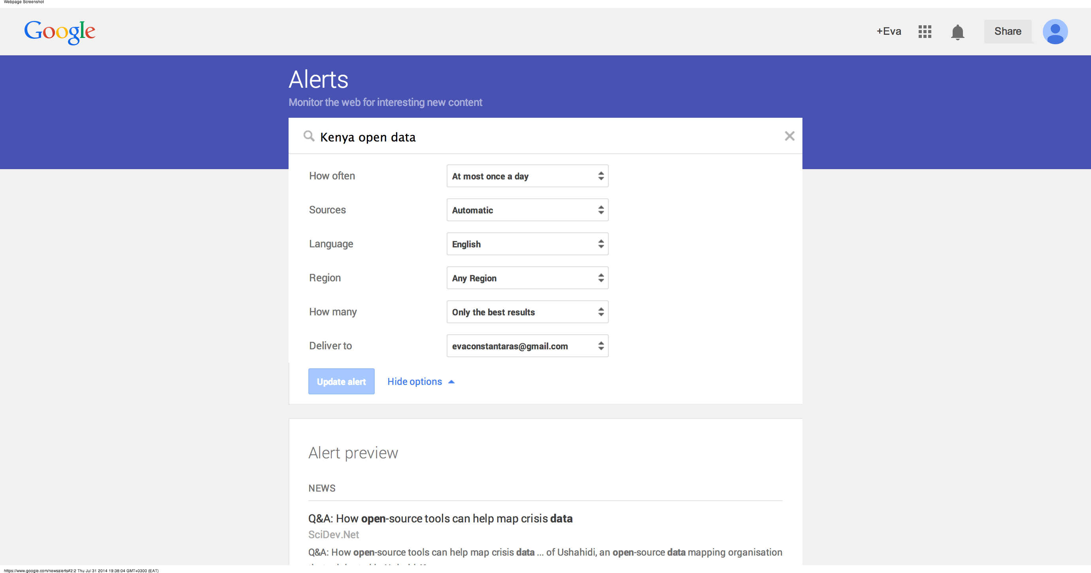
Finding Data: Advanced Google Searches Shortcuts
Google News Alerts: get notified about your beat

Slide 23
Finding Data on the Web
Get an alert every time a webpage is updated with new data:
www.changedetection.com/
Update Scanner

Slide 24
Finding Data on the Web: Exercise
Get back into your two groups:
Red flag raised as drug abuse hits Eldoret schools, colleges
7 people succumb to killer brew in Eldoret

Slide 25
Finding Data on the Web: Exercise
Return to your lists of data that would enrich Eldoret substance abuse coverage
Search for data using databases and advanced searches.
Categorize the data you have by story angle

Slide 26
Finding Data on the Web: Exercise
How much of a public health risk is substance abuse compared to other diseases?
What demographics are most affected by substance abuse?
How much is being spent on preventing and treating substance abuse?
How much is being spent to regulate illegal alcohol production?
How much money is made from the production of illegal alcohol?

Slide 27
Finding Data: No Excuses!
“We don’t have that data on a computer.”
High fees
Delay tactics
“Your request was unclear.”
Sending the wrong data
“Our database is too complicated to give you access.”
“Our database software is proprietary.”
“That information is protected by privacy law.”

Slide 28
Summary & Resources
Data is available in many different formats and almost always you will need to convert data to an Excel or csv file.
Every day, more data is available online and accessible through searches
If you can’t find it online, don’t give up!

